Slide 1


DIGITALPATH INNOVATIONS ANALYSIS
MATTHIAS ONIDOMA

Slide 2
INTRODUCTION
Digitalpath Innovations, a major stake holder in digital marketing solutions, seeks to enhance its websites user experience to improve engagement metrics, conversion rates and customer satisfaction. The Company has conducted an A/B test over a two week period , presenting two distinct versions of its webpage (version A and version B) to a randomized group of users. This experiment aims to identify which webpage version performs better across various user engagement metrics.
The Management of Digitalpath Innovations has compiled a detailed dataset capturing user interactions, behaviors and responses to each webpage version. This dataset as seen by my team presents a unique opportunity for us to analyze the effectiveness of each design, inform future design iterations and ultimately enhance user experience based on data-driven insights.
Using Tableau, we were able to analyze the dataset and the following insights were gotten from the analysis.

Slide 3
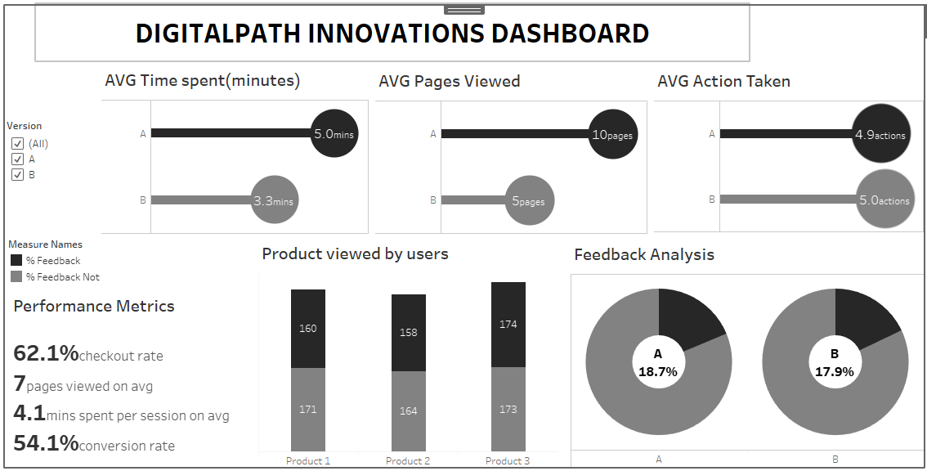

Slide 4
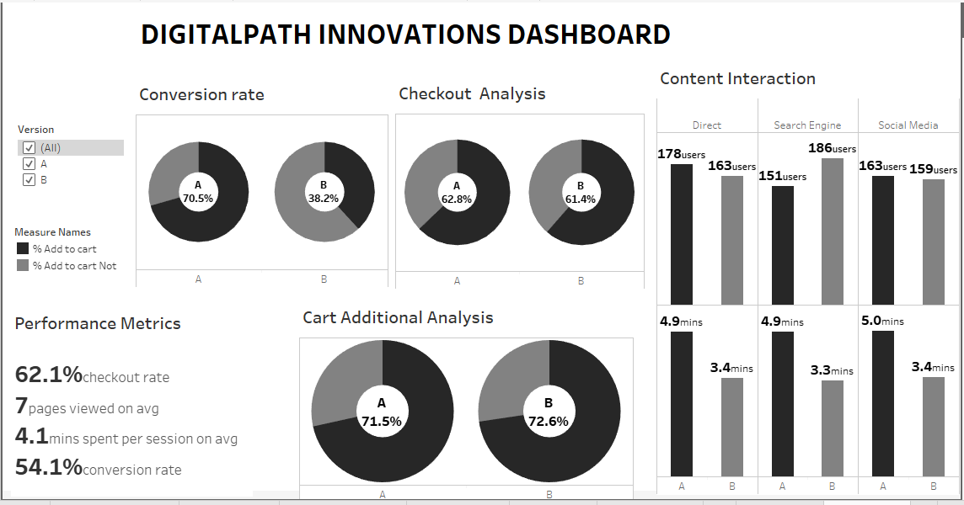

Slide 5
INSIGHTS
Although the average time spent on version B is lower than that of version A , version B is more efficient as regards action taken by the two versions.
In overall a total of 508 users viewed the three products displayed in version B while version A had 492 users that viewed their displayed products.
Version A received slightly higher feedback than version B with 18.7% and 17.9% respectively.

Slide 6
INSIGHTS CONTD.
Cart Additional Analysis showed that the number of users that added products to their cart in both versions are approximately the same.
Version A has a significant higher purchase rate than version B with conversion rates of 70.5% and 38.2% respectively which implies that version A is far more effective than version B when revenue generation is considered.
It is very visible that in version B, the search engine had the highest number of users and surprisingly they spent lesser time unlike the other media.

Slide 7
RECOMMENDATIONS
Assess the content and user experience in both versions. While longer time spent can indicate engagement, it can also mean users are struggling to find information about the products displayed. Determine if the longer time spent in A is due to positive engagement or frustration with the webpage, if the later is the case then optimize the user journey to be more efficient.
More pages viewed in version A might indicate that users are exploring more content and could suggest ease in accessing information, the Management should ensure that version B is optimized to that level.
Investigate what specific actions were taken and why version B was more effective in this aspect, despite less time spent and fewer pages viewed. If the outcome of the investigations are on the positive, then leverage the successful elements of version B to enhance version A.

Slide 8
RECOMMENDATIONS CONTD.
Since the difference in feedback is negligible, users should be encouraged to provide detailed feedback to better understand their experience while on the webpage. This could be done by making the user interface more interactive, creating a space for comments and eliminating the True/False option.
The substantial difference in the conversion rates indicates that version A is far more effective in converting users to purchasers, thereby generating more revenue than version B. Focus on understanding what aspects of version A are driving these higher conversions.
Combine the strengths of Versions A and B for better productivity, while version B is more efficient in driving actions, it lacks in conversion rate, so its efficiency in conversion rate should be increased.

